Slide 1

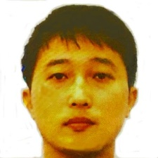
Up and Running with TensorFlow
Kyubyong Park
kyubyong.park@kakaobrain.com
www.github.com/kyubyong
Note: This file is for the hands-on session Up and Running with TensorFlow
in the first Deep Learning Conference held in Seoul on Feb. 17, 2017.
Most of the slides were adapted from the TensorFlow official web site:
https://www.tensorflow.org/get_started/basic_usage.
Explanations on each slide will be paired with brief demonstrations and exercises.
All materials are available at my github repository: https://github.com/Kyubyong/up_and_running_with_tensorflow

Slide 2
Theories (Back-prop, activation, normalization, …)
Deep Learning Hurdles
Speed of progression
Programming skills (Python, NumPy, TensorFlow, Theano, …)
Math (statistics, probabilities, linear algebra, …)
English (paper reading, lecture listening, …)
Money (GPUs, decent computer environment, …)
Up and Running with TensorFlow in Deep Learning Conference

Slide 3
Graph, Ops, Tensors
Content
Handling Arrays and Tensors
Variables, TensorFlow Fundamentals
Simple Linear Regression with TensorFlow
Regression using Neural networks
Up and Running with TensorFlow in Deep Learning Conference

Slide 4
TensorFlow is a programming system in which you represent computations as graphs.
Overview
Nodes in the graph are called Ops (short for operations).
An op takes zero or more Tensors, performs some computation, and produces zero or more Tensors.
In TensorFlow terminology, a Tensor is a typed multi-dimensional array. For example, you can represent a mini-batch of images as a 4-D array of floating point numbers with dimensions [batch, height, width, channels].
Up and Running with TensorFlow in Deep Learning Conference

Slide 5
A TensorFlow graph is a description of computations.
Overview
To compute anything, a graph MUST be launched in a Session.
A Session places the graph ops onto Devices, such as CPUs or GPUs, and provides methods to execute them.
These methods return tensors produced by ops as numpy ndarray objects in Python.
Up and Running with TensorFlow in Deep Learning Conference

Slide 6
TensorFlow programs are usually structured into a construction phase, that assembles a graph, and an execution phase that uses a session to execute ops in the graph.
The computation graph
To fetch the outputs of Ops, execute the graph with a run() call on the Session object and pass in the tensors to retrieve.
Up and Running with TensorFlow in Deep Learning Conference

Slide 7
Ops and Tensors
1
add
>> def add(a, b):
… return a + b
>> print(add(1, 2))
3
3
2
In Python
constant
>> import tensorflow as tf
# Build a graph
>> a = tf.constant(1)
>> b = tf.constant(2)
>> c = tf.add(a, b)
# Launch the graph
>> with tf.Session() as sess:
… print(sess.run(c))
3
1
a = 1
add
c = 3
constant
b = 2
2
In TensorFlow
Up and Running with TensorFlow in Deep Learning Conference

Slide 8
Open and challenge `Ch0. Graph.ipynb`.
Challenge
Up and Running with TensorFlow in Deep Learning Conference

Slide 9
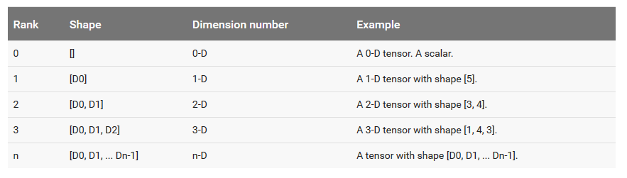
TensorFlow programs use a tensor data structure to represent all data -- only tensors are passed between operations in the computation graph.
Tensors
You can think of a TensorFlow tensor as an n-dimensional array or list. A tensor has a type, a rank, and a shape.
Tensor rank or n-dimension is the number of didmensions of the tensor.
Tensor shape is the size of every dimension.
Up and Running with TensorFlow in Deep Learning Conference

Slide 10
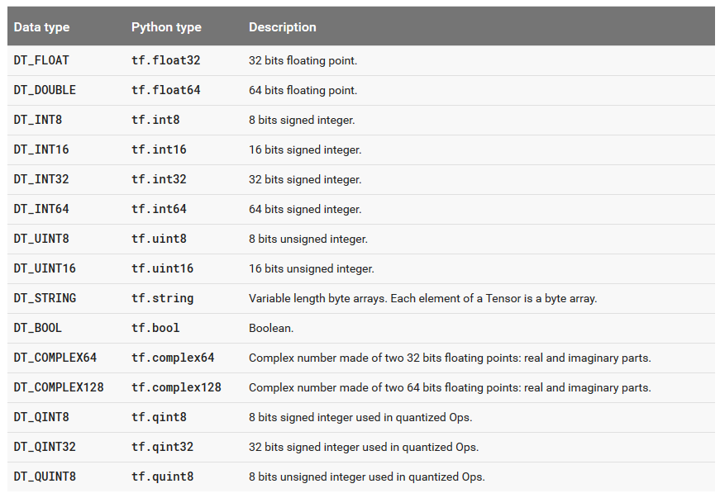
Tensors have a data type.
Tensors
Up and Running with TensorFlow in Deep Learning Conference

Slide 11
>> import tensorflow as tf >> >> x = tf.zeros([3, 5]) # Let’s peek at x >> print(x) Tensor(“zeros:0”, shape=(3, 5), dtype=float32) # Get shape >> print(x.get_shape().as_list()) [3, 5] # Python list >> shp = tf.shape(x) # Tensor # Get rank >> print(x.get_shape().ndims) 2 # Python scalar >> rnk = tf.rank(x) # Tensor # Get data type >> print(x.dtype) tf.float32
Tensors
Up and Running with TensorFlow in Deep Learning Conference

Slide 12
NumPy Arrays
NumPy
is the fundamental package for scientific computing with Python. (www.numpy.org)
has very similar APIs with TensorFlow’s.
e.g. np.reshape() == tf.reshape()
Arrays Are
typically used when feeding data in.
returned when fetching the value of tensors.
extensively used particulary in preprocessing and postprocessing.
Up and Running with TensorFlow in Deep Learning Conference

Slide 13
Download files from my another github repository https://github.com/Kyubyong/tensorflow-exercises.
Demos and Challenges
Open and check `Demo0. Create Arrays and Tensors.ipynb`.
Challenge questions 1-12 in `Constants_Sequences_and_Random_Values.ipynb`
Open and check `Demo1. Slicing and Indexing.ipynb`.
Open and check `Demo2. Math.ipynb`.
Challenge questions 1, 3, and 13 in `Math Part I.ipynb`.
Challenge questions 7 and 14 in `Math Part II.ipynb`.
Challenge question 9 in `Math Part III.ipynb`.
Challenge questions 5, 10, and 13 in `Tensor Transformation.ipynb`.
Up and Running with TensorFlow in Deep Learning Conference

Slide 14
A Variable is constructed by tf.Variable(<initial-value>).
Variables
>> a = tf.Variable(3, dtype=tf.int32)
>> b = tf.Variable(tf.random_normal([3, 2]))
A Variable is updated by tf.assign(<current-value>, <new-value>).
>> update_op = tf.assign(a, a + 2)
Variables must be initialized before you run Ops that use their value.
>> a = tf.Variable(3, dtype=tf.int32)
>> init = a.initializer
>> sess = tf.Session()
>> sess.run(init)
>> print(sess.run(a))
Up and Running with TensorFlow in Deep Learning Conference

Slide 15
Variables
You typically represent the parameter of a statistical model as a set of Variables
During training you update parameters or weights represented as a Variable by running a training graph repeatedly.
>> … Definition of Graph …
>> update_op = …
>> sess = tf.Session()
>> for step in range(100):
… sess.run(update_op)
You can save and restore variables by tf.train.Saver.save and tf.train.Saver.restore.
>> a = tf.Variable(3, dtype=tf.int32)
>> b = tf.Variable(tf.random_normal([3, 2]))
>> saver = tf.train.Saver([a, b])
>> sess = tf.Session()
>> saver.save(sess, ‘filename’)
>> saver.restore(sess, ‘filename’)
Up and Running with TensorFlow in Deep Learning Conference

Slide 16
Open and challenge `Ch1. Variables.ipynb`.
Challenge
Up and Running with TensorFlow in Deep Learning Conference

Slide 17
Placeholders and Feeds
A placeholder exists solely to serve as the target of feeds.
>> x_pl0 = tf.placeholder(tf.float32) # Any shape
>> x_pl1 = tf.placeholder(tf.float32, []) # 0-D
>> x_pl2 = tf.placeholder(tf.int32, [None]) # 1-D
>> x_pl3 = tf.placeholder(tf.float64, [None, 3]) # 2-D
A placeholder is not initialized and contains no data.
A placeholder generates an error if it is executed without a feed.
>> sess = tf.Session()
>> sess.run(x_pl0)
You must feed a value for placeholder
Up and Running with TensorFlow in Deep Learning Conference

Slide 18
TensorFlow also provides a feed mechanism for patching a tensor directly into any operation in the graph.
Placeholders and Feeds
A feed temporarily replaces the output of an operation with a tensor value. You supply feed data as an argument to a run() call. The feed is only used for the run call to which it is passed. The most common use case involves designating specific operations to be "feed" operations by using tf.placeholder() to create them:
Up and Running with TensorFlow in Deep Learning Conference

Slide 19
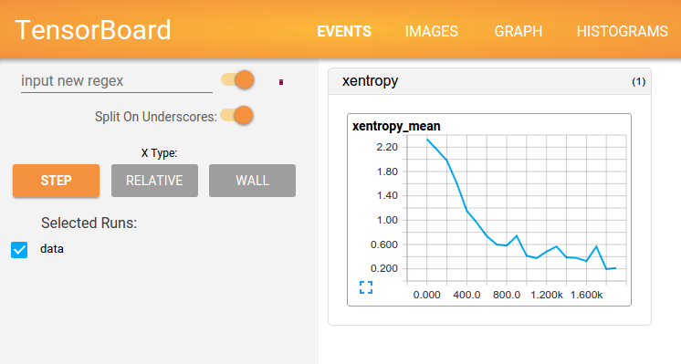
TensorBoard
You can use TensorBoard to
visualize your TensorFlow graph,
plot quantitative metrics about the execution of your graph
show additional data like images that pass through it.
Up and Running with TensorFlow in Deep Learning Conference

Slide 20
Collect Variables or (0-D)Tensors you want to record with tf.summary.scalar(name, tensor).
TensorBoard
Combine all summary Ops with tf.summary.merge_all().
>> summaries = tf.summary.merge_all()
Create a FileWriter with tf.summary.FileWriter(logdir, graph). Then an event file will be generated.
>> writer = tf.summary.FileWriter(‘asset’, tf.get_default_graph())
Fetch the content of merged summaries.
>> summary_content = sess.run(summaries)
Write the summary content to TensorBoard.
>> writer.add_summary(summary_content)
Launch the TensorBoard.
>> tensorboard –logdir=asset
Up and Running with TensorFlow in Deep Learning Conference

Slide 21
Open and challenge `Ch2. Placeholder.ipynb`.
Challenge
Up and Running with TensorFlow in Deep Learning Conference

Slide 22
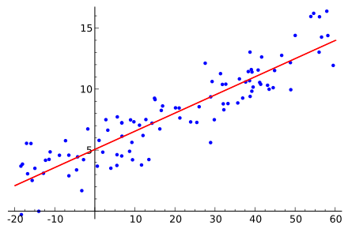
In statistics, linear regression is an approach for modeling the relationship between a scalar dependent variable y and one or more explanatory variables (or independent variables) denoted X. (https://en.wikipedia.org/wiki/Linear_regression)
Linear Regression
Up and Running with TensorFlow in Deep Learning Conference

Slide 23
Open and check `Demo3. Simple Linear Regression.ipynb`.
Challenge
Open and challenge `Ch3. Linear Regression.ipynb`.
Up and Running with TensorFlow in Deep Learning Conference

Slide 24
Open and check `Demo4. Regression with Neural Networks`.
Regression using Neural Networks (Optional)
Up and Running with TensorFlow in Deep Learning Conference

Slide 25
Thank you. + We’re hiring.
Last Comment
Up and Running with TensorFlow in Deep Learning Conference

